Slide 1
Kaiser Permanente – ML/AI COE
January 21, 2020

Slide 2

Agenda
01
Lambda architecture - overview
02
Patterns & Principles of Lambda architecture
03
Azure Lambda architecture
04
Azure Lambda architecture with Change Feed
05
Potential use case in Healthcare
06
Key takeaways
07
Appendix

Slide 3
COE

Slide 4
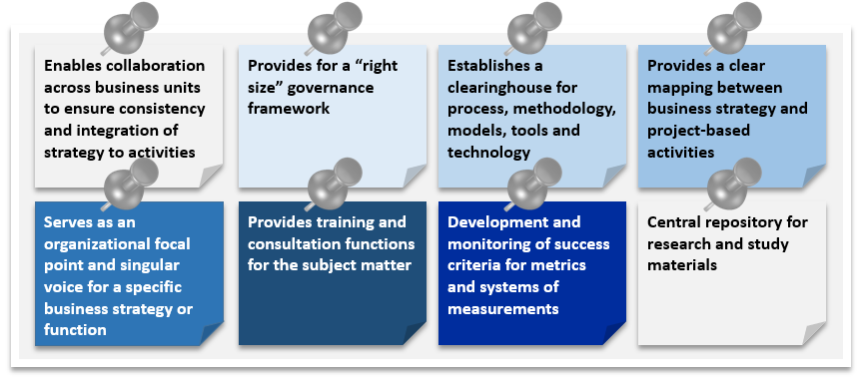
What is a COE?
A center of excellence (COE) is a team, a shared facility or an entity that provides leadership, best practices, research, support and/or training for a focus area. A "center of excellence" in one context may have completely different characteristics from another. Typically, a COE assembles a team with deep expertise in a competency to assist the rest of the organization.
Establish a set of pragmatic principles guiding the management team
A competency center to improve expertise in a certain area to improve efficiency and resource utilization
Finds best practices and disseminate them to the other areas
Provide a knowledge management - capture new knowledge and practices and make them easily accessible
A COE can be an on-going part of the business or a temporary setup
No standard model; different models can be effective in different contexts
ML/AI supports tasks not systems

Slide 5
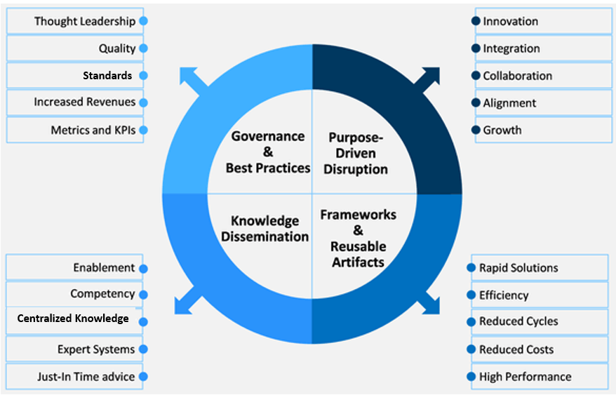
COE Responsibilities & Advantages
Responsibilities
Develop, document and establish a common set of practices and standards to ensure consistency and efficiency
Define a governance process for these practices and standards to ensure the maximum impact
Provide direct / indirect guidance and support to assist an organization in implementing these practices and standards
Knowledge management and dissemination
Develop reusable processes, tools, frameworks, components, and services
Measure the value of COE and the competency it supports
Advantages
COE can be essential in development and measurement of business success
Improve business practices and ensure predictable and repeatable outcome
Efficient resource usage
Provide quality services and products
Speed up problem solving by leveraging collective knowledge
Promote consistency and reduce complexity

Slide 6
Establish a COE
To establish a successful COE, the following steps are essential: 1). Strategy and Vision; 2). Secure funding; 3). Operationalization
Strategy and Vision
The mission statement of the COE charter should contain the following:
What is the reason for it? What are its core aspects?
The purpose of the COE helps clarify the governance and strategy
A clear set of goals to measure the effectiveness and success of it
The focus area, the scope and the team
A clear operational framework and expectation of each role
Outline the role of the COE within the greater organization
The team
COEs are built as a group of people. They can be internal or external. They can continue to hold their current positions and work in this role full-time/ part-time
Identify domain experts with required skill sets. Start with the COE manager. The responsibilities of a COE manager are to understand, record, develop, and assign job descriptions and build up the right team
Focus Area
COE tend to be built around a specific focus area, e.g., a technology, a business concept or a skill
Purpose
COE can provide research, support the organization, provide guidance, training and oversight
Secure funding
Define the funding structure. You’d require substantial funding at the outset
Create a budget plan including salaries, training, infrastructure (hardware & software costs and licenses), operational expenses, and timelines
You’ll need a champion and a sponsor
Aspects of COE
Business Strategy Alignment
IT & Data Governance Alignment
Best Practices & Standards
Templates, Frameworks & Services
Secure Funding
Advice & Consult

Slide 7
Establish a COE (cont’d)
The operationalization of a COE involves: staffing, governance, marketing, measurement of the performance, and the position of the COE within the community.
Staffing
The staffing can be full-time or part-time; they can be new hires or reassigned. Hire highly qualified and skilled people for required positions. Previous expertise in COE’s can be beneficial. Key skills required must not be compromised.
Governance
The COE should be agile, innovative and well governed. The governance structure should have minimal red tape and bureaucracy,. But the COE’s inner governance structure must be clearly laid out with roles and accountability.
Training
Document all training received . Create relevant and adequate onboarding material to induct new members in the team. Prepare training programs to suit every role’s needs. Track and share training metrics.
Leverage the knowledge base
Leverage internal knowledge base for processes, work instructions, training materials to speed up and improve results.
Execute work as per standards
Define responsibilities of each role to avoid any confusion. Specify the scope and standards to be followed.
Measurement of the performance
Define goals, metrics and measurement tools. All processes within the business should be identified and categorized.
Report periodically
Periodically generate the measurement reports for the leadership.
Marketing
COE should be marketed at every opportunity, it could help to achieve goals quicker and help to find additional funding.
Focus on the community
COE’s need to be aware of the cultural and operational environment of the community it engages with
Operational Aspects of COE
Staffing
Governance
Training
Knowledge Base
Standards
Measurement & Reporting

Slide 8
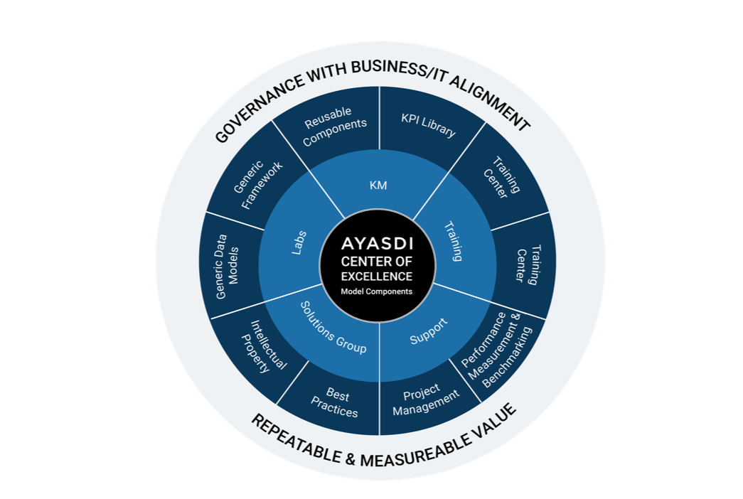
COE – Best Practices
Machine Learning Model

Slide 9
ML/AI COE

Slide 10
Machine Learning – Overview
Data Analysis
Data cleansing, preparation, Wrangling
Exploratory Data Analysis
Feature Engineering
Feature Selection
Web Scraping
Beautiful Soup
Scrapy
Re-enforcement
Urllib
Tools, e.g., Django, Flask,…
Runbooks
Languages
Deployment modes
Deployment
Programming Languages
Python
Scala
R
Java
Machine Learning
Power BI
Tableau
Matplotlib, Ggplot, Seaborn
Data Visualization
IDE
Visual Studio Code
PycCharm
Jupyter
Spyder
Statistics
Linearity
Differential Calculus
Math
Classification
Regression
Re-enforcement
Deep Learning
Dimensionality Reduction
Clustering
Machine Learning
AI is implemented using machine learning

Slide 11

Lifecycle of a Machine Learning project
Business Understanding
Domain knowledge
Requirements understanding
Use case understanding
Requirements/ Use cases
Business and use case understanding
Customer acceptance & usage
Deployment
Package model
Deploy model
Scoring/ Predictions
Performance monitoring
Data Acquisition & Understanding
Data source(s)
Data Pipeline
Data cleansing, preparation, wrangling , exploration, visualization
Environment
Lifecycle of ML Project
Modeling
Feature engineering
Feature selection
Model creation
Model training
Model evaluation
Model optimization
Deployment ready model
Curated data

Slide 12

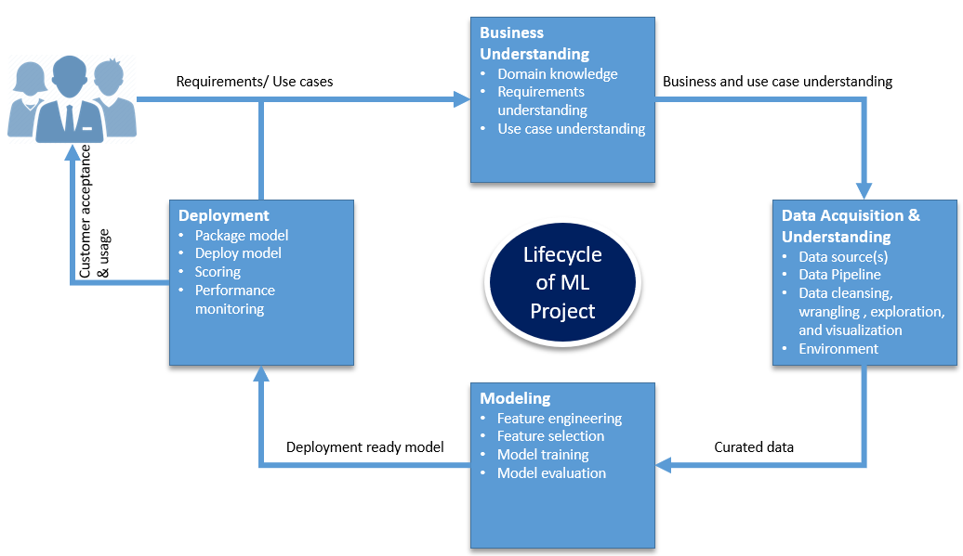



Roles in Machine Learning
Business Analyst
Data Engineer,
Data Analyst
Software Engineer, Data Engineer
Data Scientist (Advisory)
Software Engineer
(Data Visualization)
Data Scientist

Slide 13
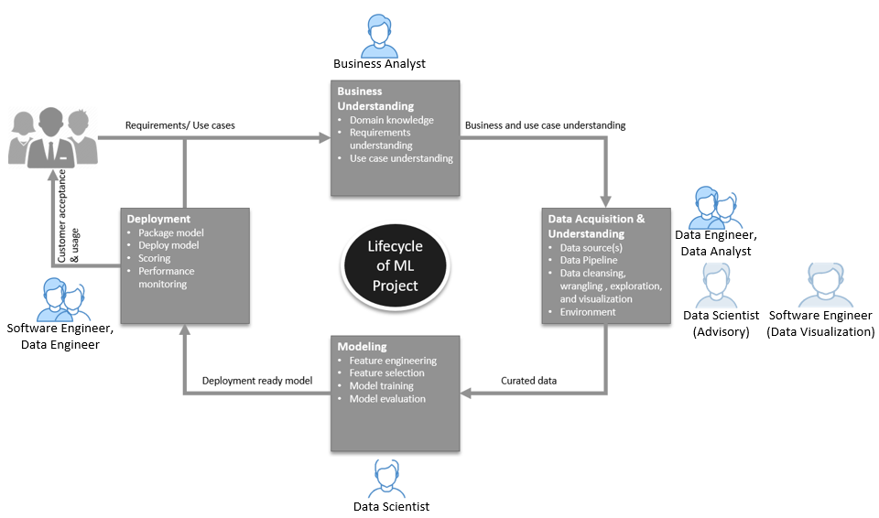
Roles and Responsibilities in a Machine Learning project
Business Analyst
Gather requirements
A liaison between Data Analysts and business stakeholders
Run stakeholder meetings
Make Presentations
Software Engineer
Help Data Scientist write scripts
Ensure standards and policies are followed
Implement access controls and policies
Create deployment packages
Help deployment teams with the ML service deployment
Help preserve source code, binaries and versions
Data Analyst
Determine data quality
Help select appropriate data set
Help curate data
Visualize data
Data Engineer
Identify data source(s)
Extract & reshape data
Create data access & storage services
Select appropriate storage type and tier
Build data pipeline
Data Scientist
Help data identification & curation
Model building
Model testing
Model optimization
Help model deployment

Slide 14
Roles and Skill Competencies in a Machine Learning project
Software Engineer
Help Data Scientist write scripts
Ensure standards and policies are followed
Appropriate access controls and policies are used
Create deployment packages
Help deployment teams with the ML service deployment
Help preserve source code, binaries and versions
Business Analyst
Business domain knowledge
Effective business requirements gathering
Run stakeholder meetings
Good presentation skills
Great communication skills
Always in-sync with stakeholders and product owners
Data Analyst
Determine what data will be required
Clear communication skills
Some programming skills, e.g., SQL
Competent in data visualization tools, e.g., Power BI, Tableau, Matplotlib, etc.
The more data knowledge, the better Data Analyst
Data Scientist
An applied mathematics, statistics along with computer science
Ability to choose appropriate machine learning algorithms, train them, and devise accuracy test plans
Programming languages such as, Python, Scala, R, SQL
Interact with Data Analysts to cultivate the desired insights
Data analysis to help businesses use their data assets
Expert in data storytelling to layout complex results and observations in laymen’s terms
Data Engineer
Programming background, possibly a computer science degree, and languages such as, Python, Scala, Java, SQL
Create data pipelines at scale, integrating big data technologies
Deep understanding of data technologies and frameworks and integration with data pipelines
Work with teams responsible for clusters, DevOps, and DataOps
Implement machine learning algorithms chosen by data scientist

Slide 15

Thoughts from the practitioners
The items depicted below are thoughts and experiences shared by Machine Learning practitioners. They should provide pragmatic guidance for the successful creation and adoption of a ML/AI COE.
Domain expertise is essential
Business analyst, data analyst, data scientist and data engineer need to work together
Cross training is beneficial
Business analyst and data scientist work on data enrichment process
Data engineer does the data cleansing, wrangling and enrichment
Data Scientist provides the Math and creates modeling
Software engineering creates deployment and service endpoints
Expect to deal with structured data (e.g., database data, spreadsheet), semi-structured data (e.g., XML, JSON) and or unstructured data (log files, audio, video, social media)
Data curation skills such as, handle Null values, handle imbalances, remove Noise, cleanse data, normalize data, and categorize data are essential for feature engineering and selection
Most frequently used well-known Math concepts: Linear Algebra; Matrix algebra and eigenvalues; Calculus for Data Science; Derivatives and gradients; Gradient Descent, and a simple neural network
Some well-known Math packages: Pandas - for data wrangling, NumPy - for large, multi-dimensional arrays, matrices, and high-level mathematical functions, SciPy - for linear algebra, interpolation, optimization, integration, and statistics, Matplotlib- for an object-oriented API for embedding plots into applications, Seaborn for data visualization , Scikit Learn for supervised and unsupervised learning algorithms, and TensorFlow - to create large-scale neural networks
To create a model - Adopt the 5E’s model approach - Engage, Explore, Explain, Elaborate, and evaluate
Use data access
Use regression and classification to make predictions

Slide 16
Thoughts from the practitioners (cont’d)
Create Prototype‐based models
Apply model to data and validate
Start with the internal data - cleanse, wrangle and enrich data
Compare old model to new model
Compare different models
The input data can be biased
Prevent model bias - use a representative dataset, choose the right model, perform real-world testing on real-world datasets; Use multiple people to code the data, have participants review results, use disparate data sources, check for alternative explanations, review findings with peers
Deploy - AWS cloud, API Gateway control, Direct Connect, Django, Flask, Azure Runbooks, ML Studio
Implement Machine Learning as a service to provide real-time predictions
Implement Stream analytics and machine learning capabilities to provide recommendations and detect fraud/issues in real-time
Lessons Learned
Business owners and product owners are critical
Good data is very important - data cleansing, preparation and enrichment are critical
Must have knowledge to create models and the judgment to use the right models
Leverage automatic model tuning using tools such as, Autopiler, AWS SageMaker, Azure HyperParameters
Data engineers to need to ensure data pipeline with appropriate roadmaps

Slide 17
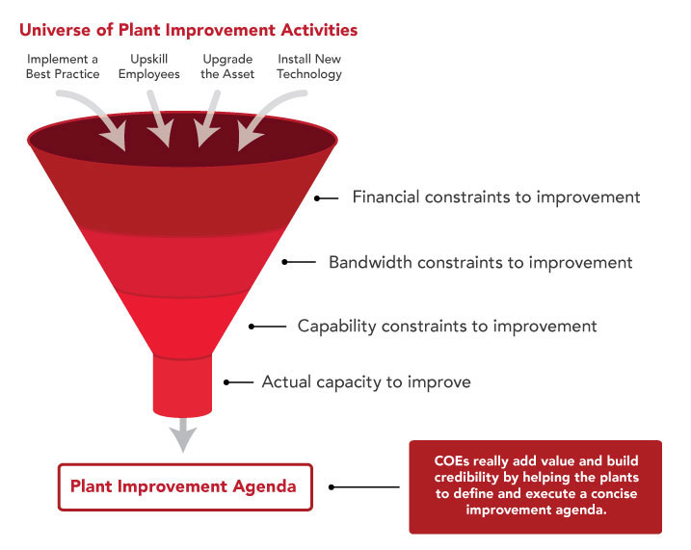
Lessons Learned
Lessons learned is an opportunity to learn from the actual experiences of others, avoid mistakes of the past and increase effectiveness and efficiency of future endeavors.
Planned improvements
Reality has to be factored into the model
COE must avoid the ivory tower approach
Help customers pinpoint the problem and how a change can be applied
Provide pragmatic guidance/solutions
COE is a journey. Operational maturity should only be considered as a means to an end, not an end to itself
The process of establishing the COE shouldn’t be taken lightly - properly define its vision and strategies
Ensure the COE has appropriate financing
Create a lean management structure that provides knowledge throughout the organization
A champion and a sponsor are critical to its success
COE adds value and build credibility by helping customers define and execute a concise agenda.
Actual improvements
Contrast between defined vs. actual realities

Slide 18
Appendix

Slide 19
Glossary of terms
Feature Engineering is the process of adding new features or transforming existing features in the input dataset. The goal of Feature Engineering is to create features that will greatly strengthen the model in terms of performance or accuracy.
Feature Selection is the process of selecting a subset of relevant, useful features to use in building an analytical model. It helps narrow the field of data to the most valuable inputs, which helps reduce noise and improve training performance.
Scoring is also called prediction, and is the process of generating values based on a trained machine learning model, given some new input data. The values or scores that are created can represent predictions of future values, but they might also represent a likely category or outcome.

Slide 21

Work in Progress

Slide 22
Machine Learning

Slide 23
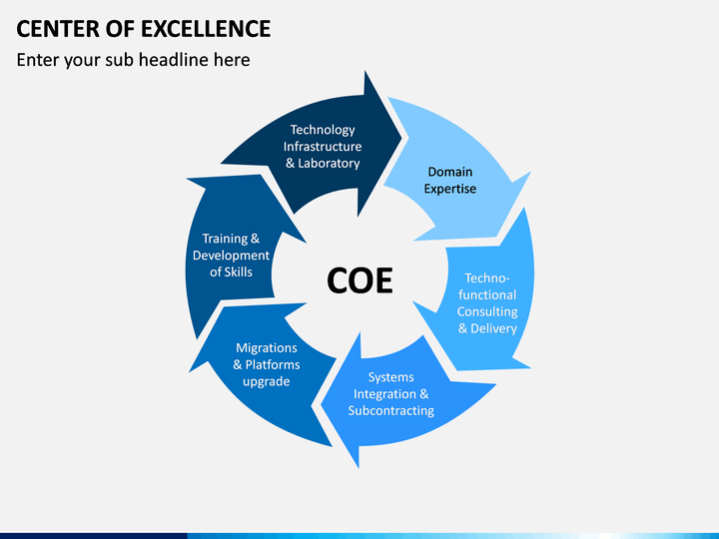

Slide 24
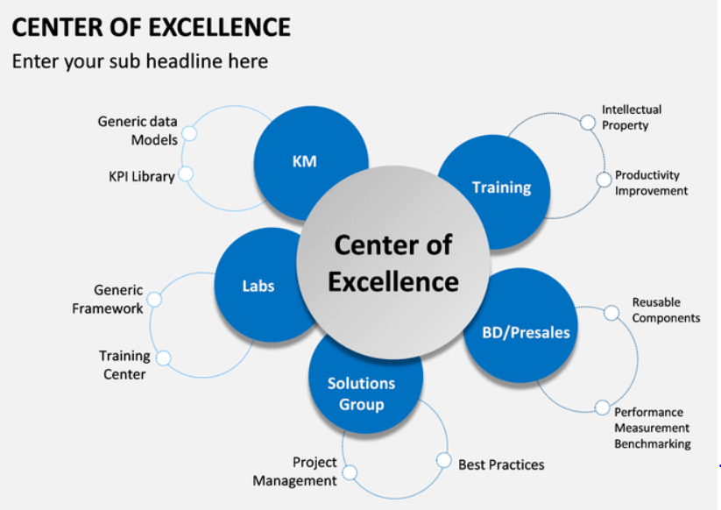

Slide 25
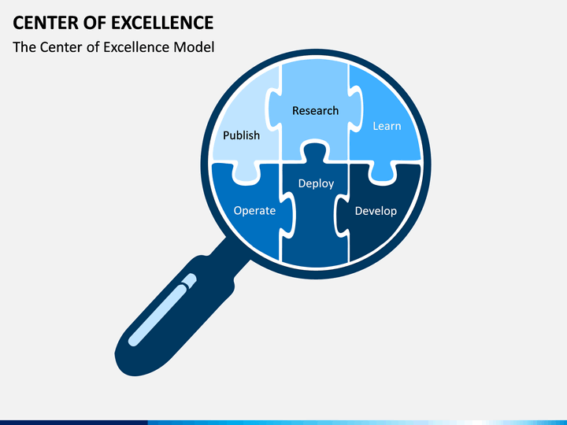

Slide 26
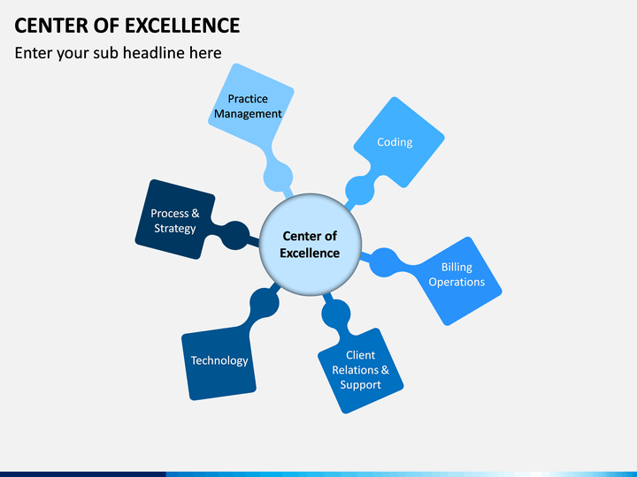

Slide 27
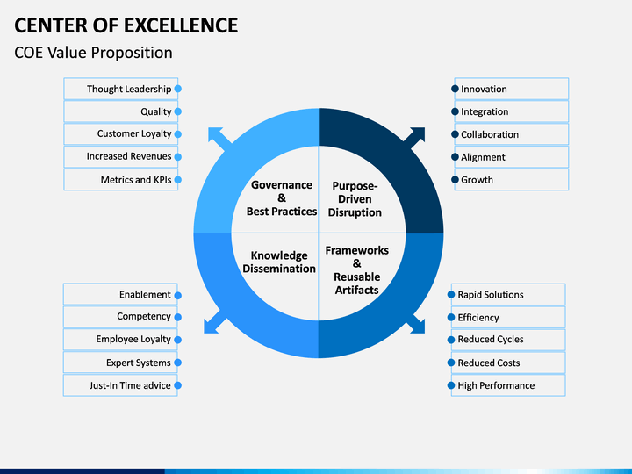

Slide 28
Lifecycle of a Machine Learning project
Lifecycle of ML Project
Data Collection
Big Data Eng.
3rd Party APIs
Web Scraping
Deployment
Deploy model using Organization approved tool/practice
Feature Engineering
Handle Null values
Handle imbalances
Remove Noise
Cleanse Data
Normalize Data
Categorize Data
Testing Model
Test model using multiple variations
Feature Selection
Pearson Correlation
Heat Map
Extra Tree Classifier
Modeling
Select the right model

Slide 29
Roles in Machine Learning
Data Sources
External Data Sources
Vendors & Partners
Social media
3rd Party
Government Agency
Internal Data Sources
System of records
Business Transactions
Data Streams
System logs
Data Engineer
Exploratory Data Analysis (EDA)
Data Visualization
Data Analyst
Model Creation
Data Scientist
Model Deployment
Software Engineer
Model Optimization
Roles in Machine Learning

Slide 30
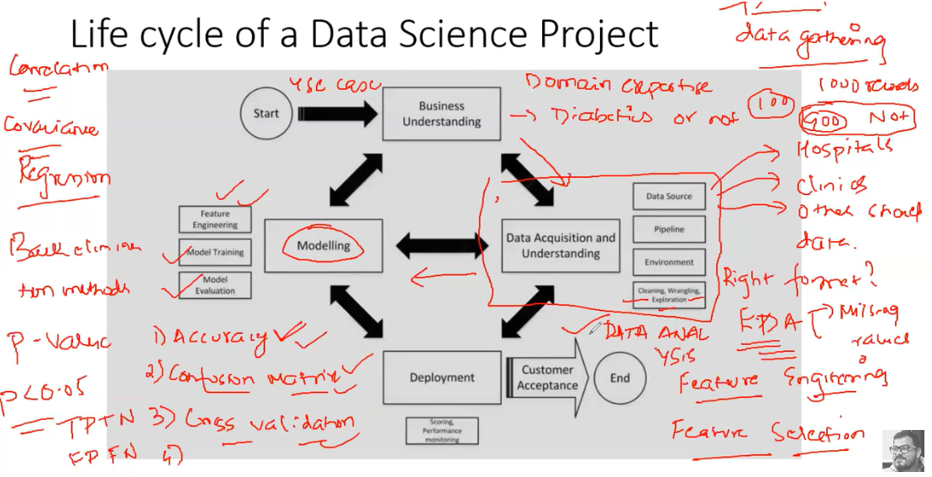

Slide 31
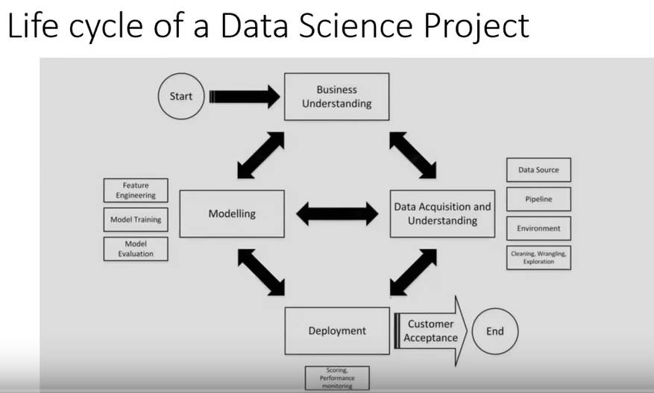

Slide 32
Roles and Responsibilities in a Machine Learning project
Data Scientist
Data collection
Data preparation
Exploratory Data Analysis (EDA)
Evaluation & Interpretation EDA
Model building, testing, Optimization
Model deployment
Data Engineer
Identify data source
Extract data
Create data storage
Select appropriate storage type and tier
Roles & Responsibilities in ML Project
Data Analyst
Works with Data Scientist to determine data quality
Helps Data Scientist select appropriate data set
Help Data Scientist curate data
Visualize data
Software Engineer
Helps Data Scientist write scripts
Ensure organization standards are followed
Ensure proper access controls and policies are adhered to
Works with the deployment teams to ensure the ML service is properly deployed to various environments, including production
Helps Data Scientist ensure the source code is preserved and appropriate versions are maintained

Slide 33
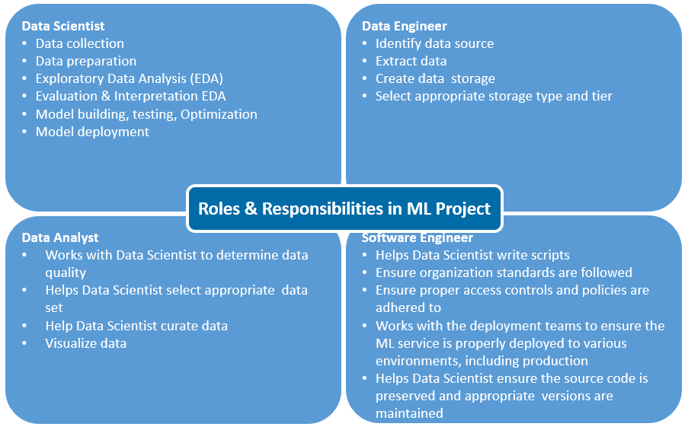
Skill Competencies required
An applied mathematics and/or statistics background coupled with computer science
Ability to choose appropriate machine learning algorithms, train them, and devise methods for testing their accuracy
Must know programming languages such as, Python, R, etc.
Need to interact with business domain experts in order to cultivate the desired insights
Analyze data (EDA) to help the business utilize their data assets
Must be well-versed in the art of data storytelling to layout complex results and observations in laymen’s terms
Programming background, possibly as a result of a computer science degree with languages like Python, Scala, Java, SQL
Create data pipelines at scale, integrating a number of big data technologies
An in-depth understanding of data technologies and frameworks and how to integrate them with data pipelines
Work closely with teams responsible for clusters, DevOps, and DataOps
Implement machine learning algorithms chosen by data scientists for a production environment
Determine what data will be required
Clear communication skills
Good programming skills
Great communication skills
Expertise in data visualization tools,
The more data knowledge, the better Data Analyst
Expertise in programming languages, possibly as a result of a computer science degree with languages like Python, Scala, Java, SQL
Ability to architect solutions to create well-balanced solutions
Knowledge of standards, best practices, and regulatory requirements
Ability to create software package(s) and externalize dependencies and parameters
Familiar with source code, dependencies, versions and binaries management

Slide 34
Standards
Centralized Knowledge

Slide 35

Enables collaboration across business units to ensure consistency and integration of strategy to activities
Provides for a “right size” governance framework
Establishes a clearinghouse for process, methodology, models, tools and technology
Provides a clear mapping between business strategy and project-based activities
Serves as an organizational focal point and singular voice for a specific business strategy or function
Provides training and consultation functions for the subject matter
Development and monitoring of success criteria for metrics and systems of measurements
Central repository for research and study materials

